Slide 1

Let azure control your pipelines…
because you can’t trust yourself to do it
Email: petender@microsoft.com Twitter: @pdtit Blog: https://aka.ms/pdtit

Slide 2
What will be covered
WHY/WHAT
HOW
DEMOS
MORE DEMOS
Q & A

Slide 3
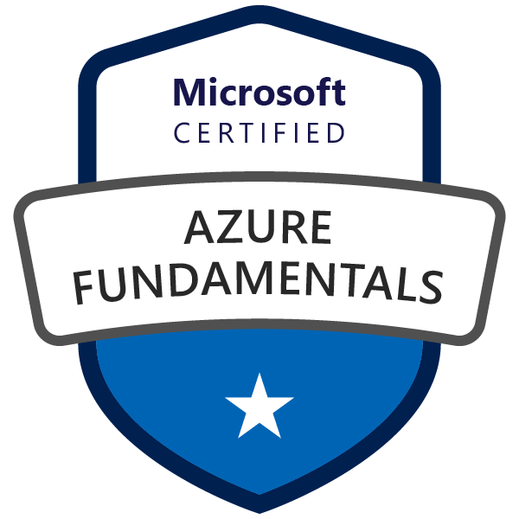
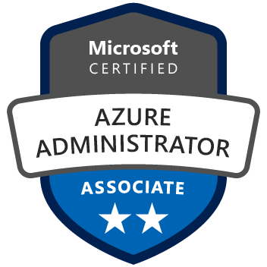



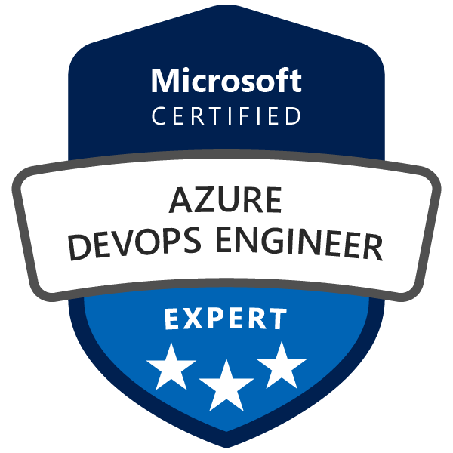
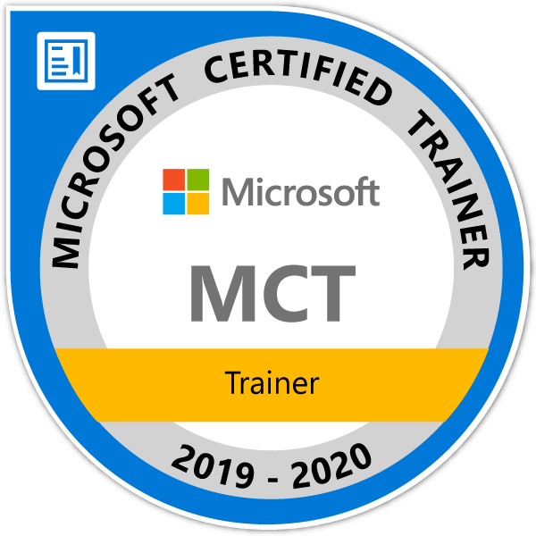

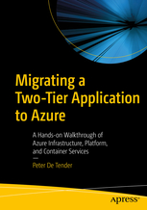
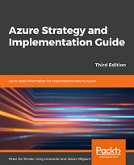
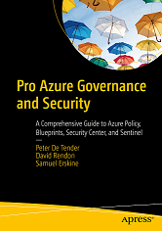
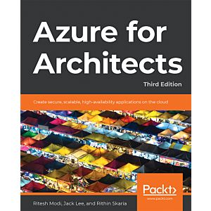
Peter De Tender
Azure Technical Trainer | DevOps Cloud Advocacy v-team Member
+25 years background in Microsoft Technologies
+12 years MCT, Former Azure MVP (5y)
Last 8 years 100% focus on Azure
Technical writer, book author and technical blogger
HashiCorp Ambassador 2020-2022
“...Bring me an audience, I give them Azure knowledge in return...”
{
Email: petender@microsoft.com
Twitter: @pdtit
Blog: https://www.007FFFLearning.com
}

Slide 4
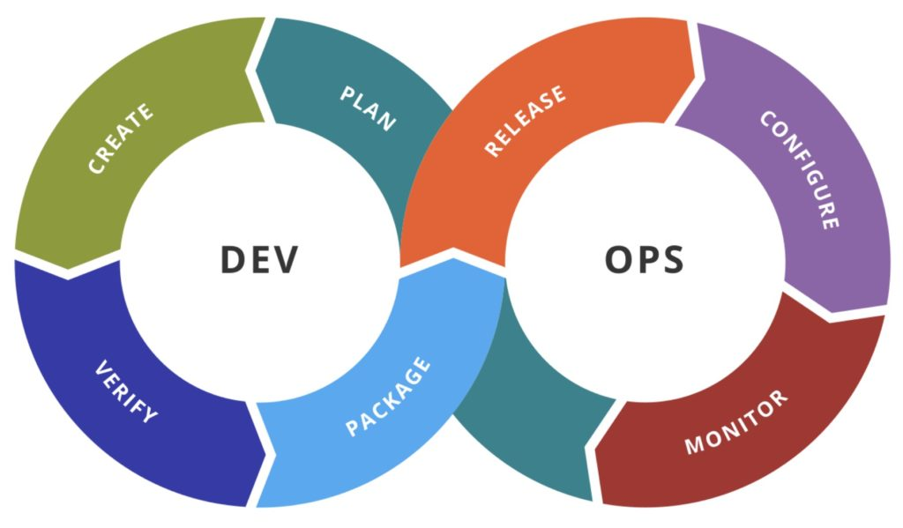
WHY / WHAT OF PIPELINE CONTROLS
DEVOPS TEAMS CONTROL DEVOPS PIPELINES
AZURE TEAMS CONTROL AZURE
SECURITY TEAMS CONTROL SECURITY
DEVELOPERS NEED TO FIX OPEN BUGS/ISSUES BY NEXT SPRINT
WHY DEPLOYING IF TARGET IS FACING AN OUTAGE
DEPLOYING WHEN SOURCE IS FACING AN OUTAGE (SRE-minded) …
=> conflicts (which is against the whole DevOps Concept ☺)
=> we all want successful pipeline runs (CI/CD)

Slide 5
How OF PIPELINE CONTROLS
AZURE GOVERNANCE
Use Azure AD Integrated Authentication to ADO DevOps Team
Use Azure RBAC enabled Service Principals for ADO Service Connections
Use Azure Policies to lock down what can / cannot be deployed

Slide 6
Demo
Service Connections
- Automatic vs manual
Notes:
Demo Scenarios
Approvals & Pull Requests
From ADO PU Project / Settings / Repositories / select a specific branch petender-updates / settings – approvers
Open the source code folder c:\partsunlimited in VSCode, edit a file and run a commit + push
Create a new Pull Request and show the reviewers field
ADO Security Scanner
Open DevOps / Parts Unlimited / PU-ASPNet-Classic Pipeline, and show the ADO Security Scanner Task
Run the pipeline, or open an already completed job + show details of scanning
From dashboards,

Slide 7
How OF PIPELINE CONTROLS
AZURE GOVERNANCE
Use Azure AD Integrated Authentication to ADO DevOps Team
Use Azure RBAC enabled Service Principals for ADO Service Connections
Use Azure Policies to lock down what can / cannot be deployed
AZURE DEVOPS GOVERNANCE
Approvals for Repos & Pipelines
Azure DevOps Release Gates / Quality Gates
Azure DevOps Environments

Slide 8
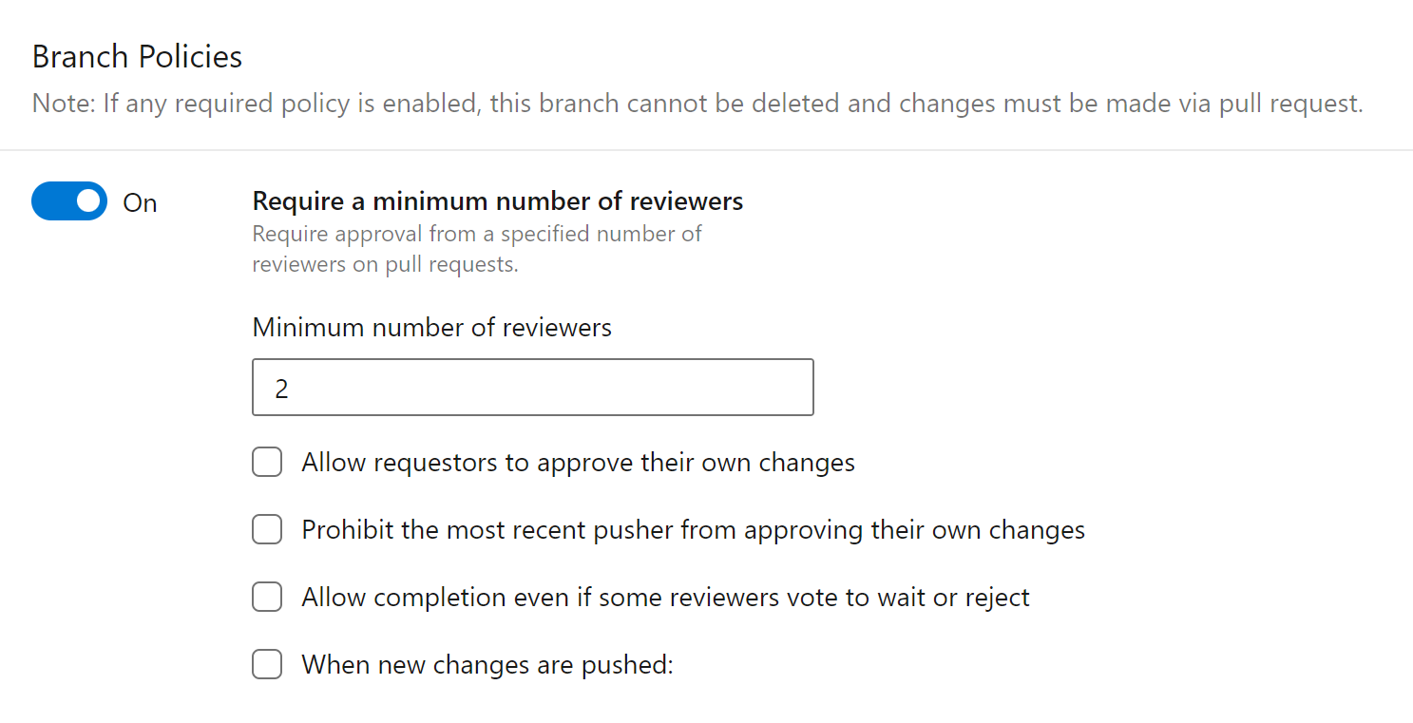
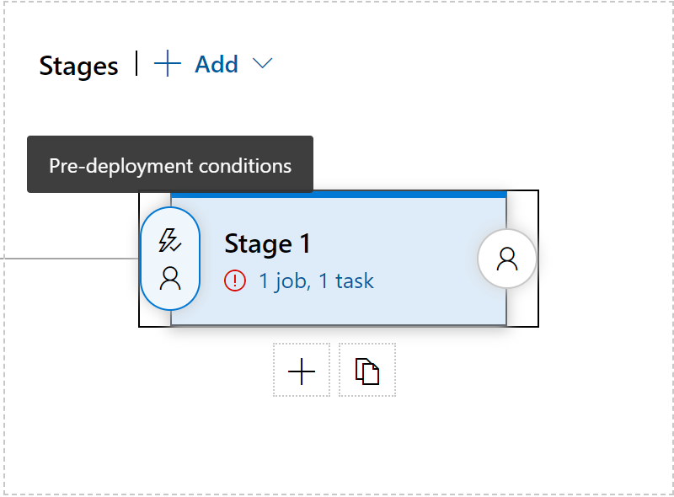
approvals
Branch-Policies + Pull Requests
Pre- & Post Pipeline Stage approvals

Slide 9
Demo
Branch Policies
PRE-/POST- Stage Approvals
Notes:
Demo Scenarios
Approvals & Pull Requests
From ADO PU Project / Settings / Repositories / select a specific branch petender-updates / settings – approvers
Open the source code folder c:\partsunlimited in VSCode, edit a file and run a commit + push
Create a new Pull Request and show the reviewers field
ADO Security Scanner
Open DevOps / Parts Unlimited / PU-ASPNet-Classic Pipeline, and show the ADO Security Scanner Task
Run the pipeline, or open an already completed job + show details of scanning
From dashboards,

Slide 10
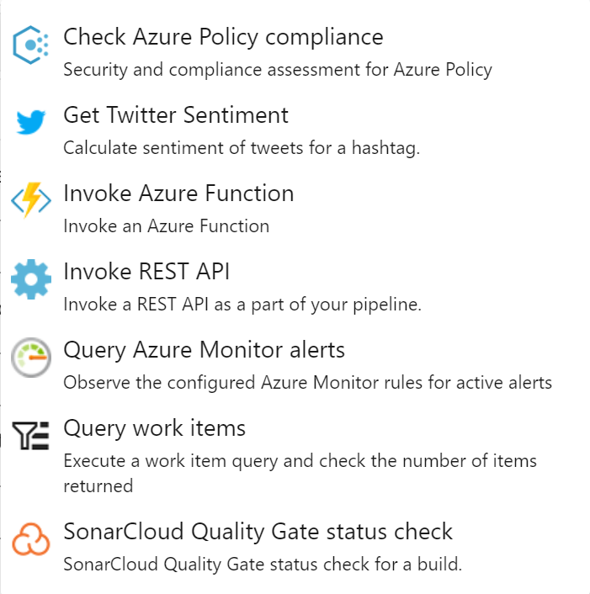
Release Gates / Quality gates
Validate Work Items
Check Azure Policies
Interact with Azure Monitor Alerts
Invoke Azure Function (POWERSHELL FOLKS!!)
Invoke REST API
3rd party integration (e.g. Secure Code Scanning)

Slide 11
Demo
Release Gates
Notes:
Demo Scenarios
Approvals & Pull Requests
From ADO PU Project / Settings / Repositories / select a specific branch petender-updates / settings – approvers
Open the source code folder c:\partsunlimited in VSCode, edit a file and run a commit + push
Create a new Pull Request and show the reviewers field
ADO Security Scanner
Open DevOps / Parts Unlimited / PU-ASPNet-Classic Pipeline, and show the ADO Security Scanner Task
Run the pipeline, or open an already completed job + show details of scanning
From dashboards,

Slide 12
Release Gates / Quality gates
“…WAY COOL PETER, BUT…
THIS DOES ONLY WORK IN AZURE CLASSIC PIPELINES”
source: AZ-400 learner
TRUE (but who uses YAML anyway ☺)
If you like YAML, use GitHub Actions

Slide 13
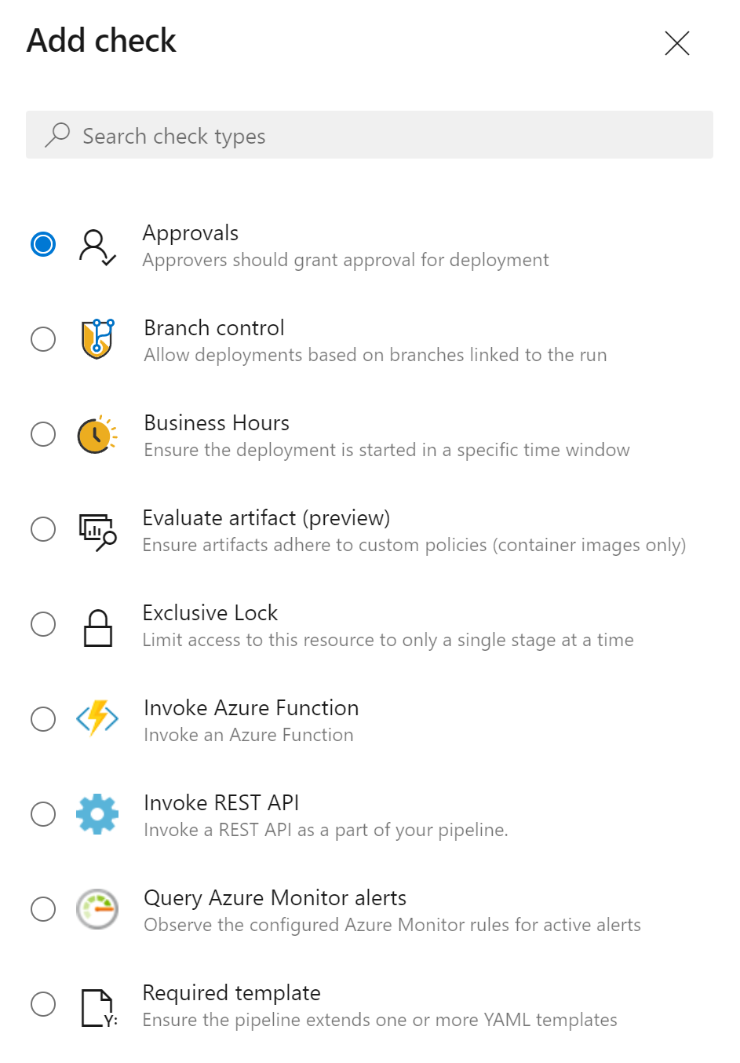
Release Gates / Quality gates – in YAML
“…EVEN BETTER MY DEAR LEARNER, REUSE YOUR RELEASE GATES FEATURES IN AZURE DEVOPS YAML PIPELINES…”
source: PETER
Azure DevOps Environments
environment: Release

Slide 14
Demo
Release Gates in YAML PIPELINES
Notes:
Demo Scenarios
Approvals & Pull Requests
From ADO PU Project / Settings / Repositories / select a specific branch petender-updates / settings – approvers
Open the source code folder c:\partsunlimited in VSCode, edit a file and run a commit + push
Create a new Pull Request and show the reviewers field
ADO Security Scanner
Open DevOps / Parts Unlimited / PU-ASPNet-Classic Pipeline, and show the ADO Security Scanner Task
Run the pipeline, or open an already completed job + show details of scanning
From dashboards,

Slide 15
What we covered
WHY/WHAT
HOW
DEMOS
MORE DEMOS
Q & A

Slide 16

Thank you
petender@microsoft.com
https://twitter.com/pdtit
http://aka.ms/pdtit
Step guide: https://aka.ms/adogates-howto

